Slide 1
Final Assessment Excel
Name: Godula Pooja
EmpID: 4360

Slide 2
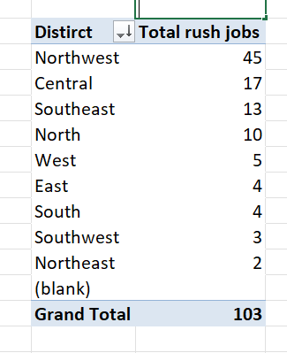
2.District which has the highest number of rush jobs
Northwest has the highest number of rush jobs i.e,45

Slide 3
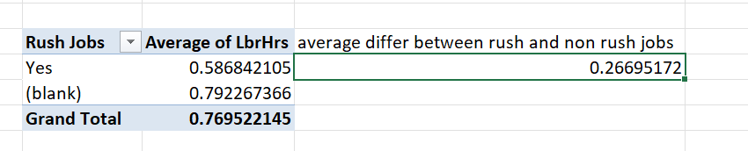
3.Average labour hours differ between rush and non-rush jobs
For rush jobs, it takes 0.586 hrs.
For non-rush jobs, it takes 0.7922 hrs
Average labour hrs differ is 0.266 hrs

Slide 4
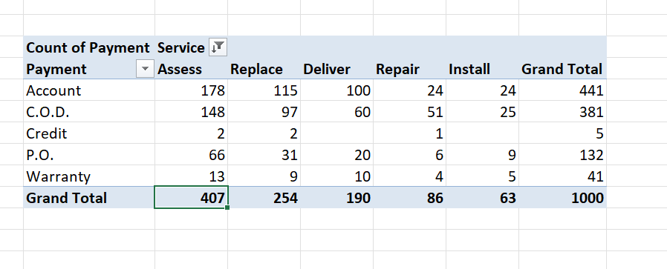
4.Distribution of payment across services
Every services preferred the payment type “account” more.
If not account type payment, they preferred “C.O.D”.

Slide 5
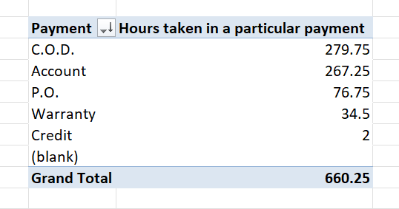
5.Distribution of Payment over time(Hours)
Hours taken in the C.O.D payment is high.
Hours taken in the credit payment is low.

Slide 6
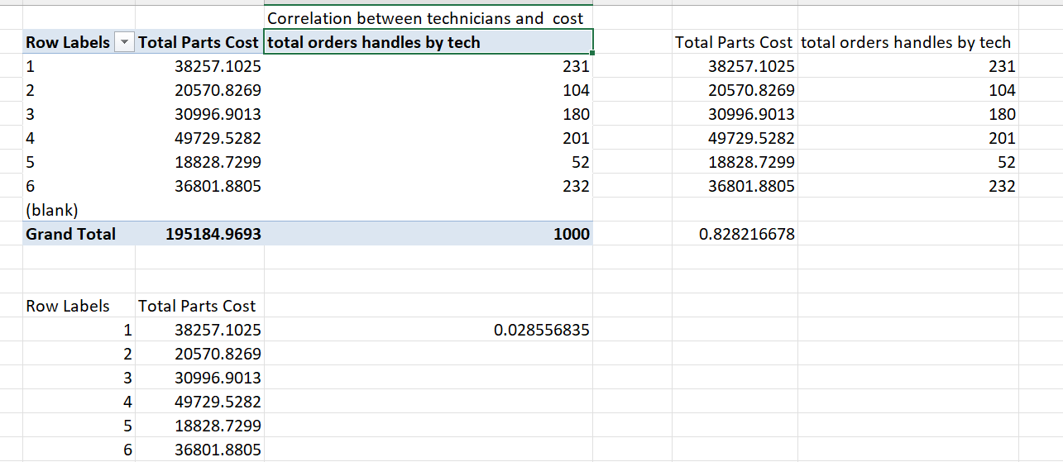
6.Relationship between number of technicians and cost of parts
Correlation between number of technicians and cost of parts is “POSITIVE”. So, if cost of parts increases, then the technicians also increases to take care the cost.
Correlation Value: 0.02855

Slide 7
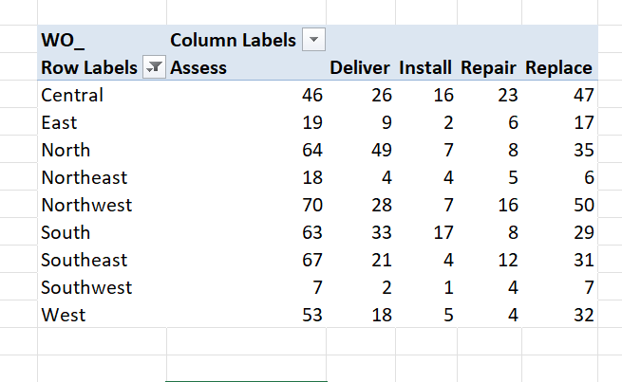
7.Most used services in each district
Every district most used service is assess.

Slide 8
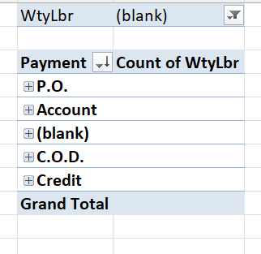
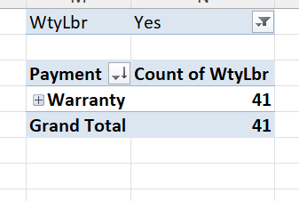
8.Distribution of payment for workorders with warranty labour and without
No there is no difference in payment for workorders with warranty labor and without

Slide 9
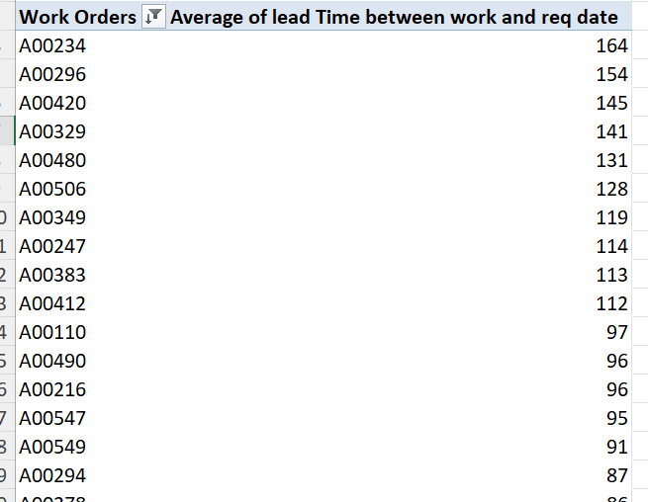
1.Average lead time between request date and completion date
For an order, it took average 164 days to be completed.

Slide 10
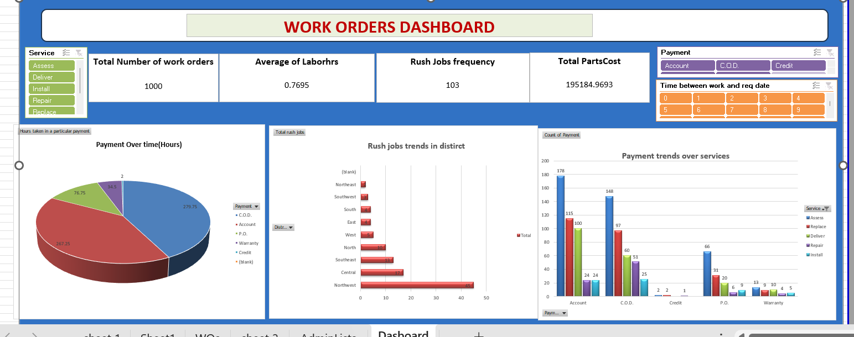
Dashboard

